Slide 1

Script of Scripts
Polyglot Notebook and Workflow System for both Interactive Multi-language Data Analysis and Batch Data Processing
Bo Peng, PhD
Department of Bioinformatics and Computational Biology
The University of Texas MD Anderson Cancer Center

Slide 2
A quick survey
Introduction
Have you used more than one Jupyter kernels?
Have you used more than one Jupyter kernels for a single project?
Have you used Jupyter to analyze large data?
Have you used any workflow system for your work?
Notes:
My answers to all these questions are yes.

Slide 3
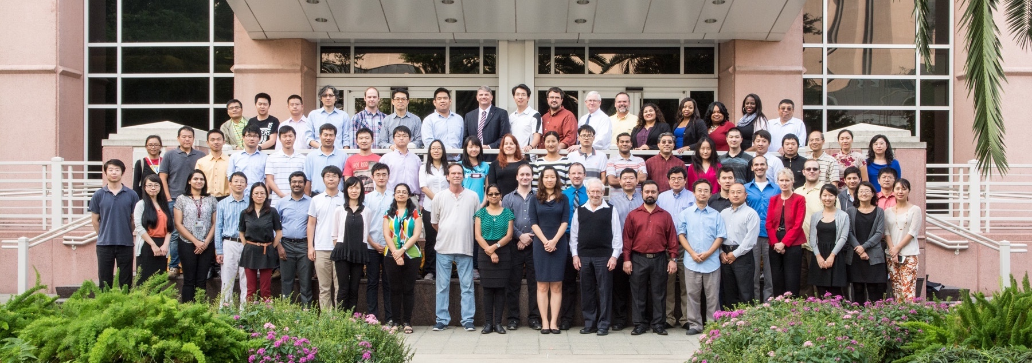
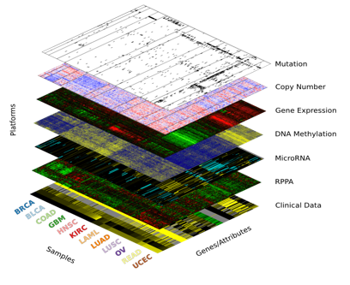
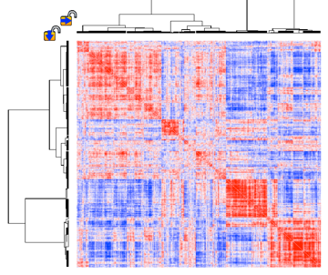
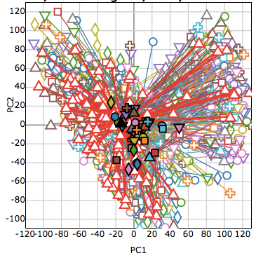
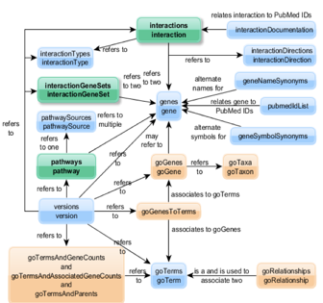
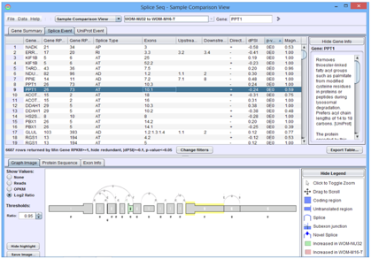
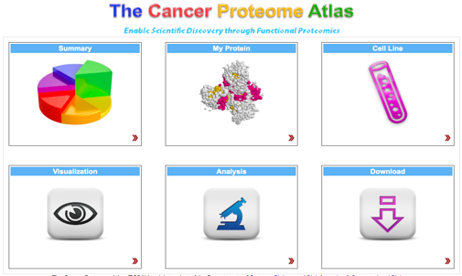
Who we are and what we do
Introduction
Notes:
We are MD Anderson Cancer
One of the largest and best cancer hospital in the world
One of the largest bioinformatics department in the nation
We have 15 faculty have who made major contribution to many of the national and international projects such as TCGA and ICGC.
We have a large statistical analysts team with 20 PhDs (or double MS) who worked on almost 400 projects for more than 100 Principal Investigators at MD Anderson.
Basically, we deal with a lot of data.

Slide 4








Our computational environment
Introduction
Notes:
Data usually come from our labs
Bioinformatics need to use all different tools in many languages

Slide 5








workflow
Write and manage scripts written in different languages for different environments
Understand and reproduce others’ (and sometimes my own) projects
Manage data and workflows on different environments for batch data processing

Slide 6


The promises of Jupyter ecosystem
Introduction
Supports virtually all scripting languages
Unified notebook format and interface
Flexible client/server architecture
JupyterHub for enterprise
JupyterLab was around the corner (now ready for users)
Binder for reproducible data analysis
Notes:
JupyterCon so I will save the time

Slide 7
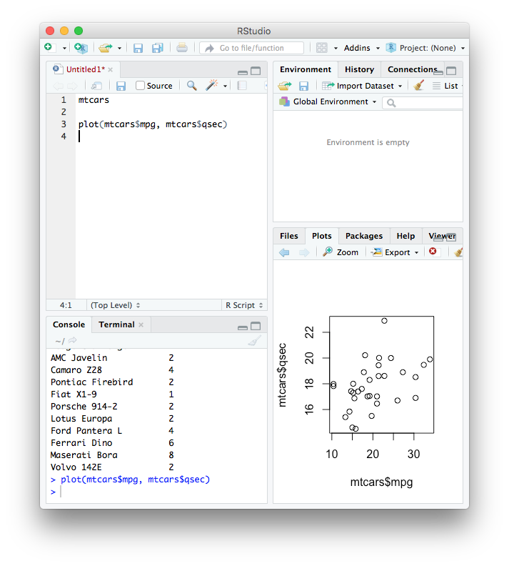

What was missing for our work?
Introduction
snakemake
More IDE features for interactive data analysis
Multi-language support
Integrated workflow system for batch data processing
Notes:
Compared to R Studio
Line-by-line execution in console window
Variable inspector
Preview of variables, figures etc
Jupyter supports only one kernel in a notebook
Multiple notebooks
BeakerX does not support MATLAB and SAS
Needs workflow system for batch data processing
Usain Bolt competing with Michael Phelps for swimming
Different environments counter productive

Slide 8
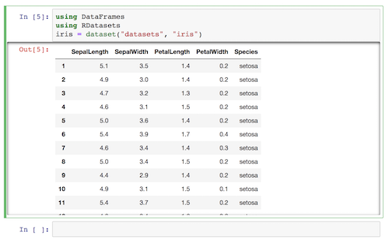

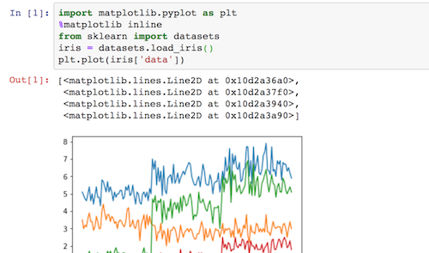

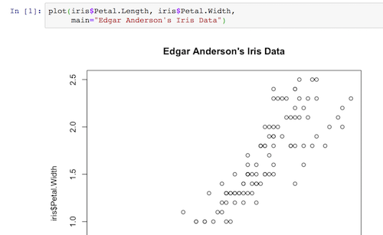

SoS Polyglot Notebook
Introduction
Notebook Server
Kernel
Notebook Server
Kernel
Notebook Server
Kernel

Slide 9
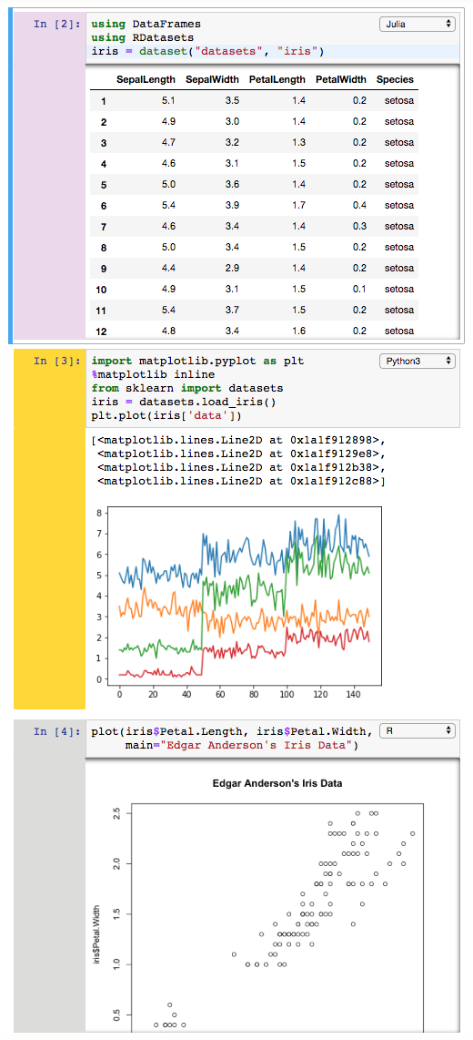
SoS Polyglot Notebook
Introduction
Kernel
Notebook Server
Kernel
Kernel
Kernel

Slide 10



Introduction
SoS Workflow System
Kernel
Notebook Server
Kernel
Kernel
Kernel
Workflow System

Slide 11
Polyglot Notebook
+
=
Polyglot Notebook
Workflow System
Working Environment
Notes:
Start at 8

Slide 12
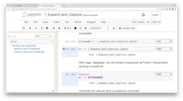
A super kernel to all jupyter kernels
Polyglot Notebook
Starts and shuts down subkernels
Receives input from frontend, (optionally) processes it, sends it to subkernels
Receives output from subkernels, (optionally) processes it, sends to frontend
Kernel
%expand
%capture
Subkernel

Slide 13
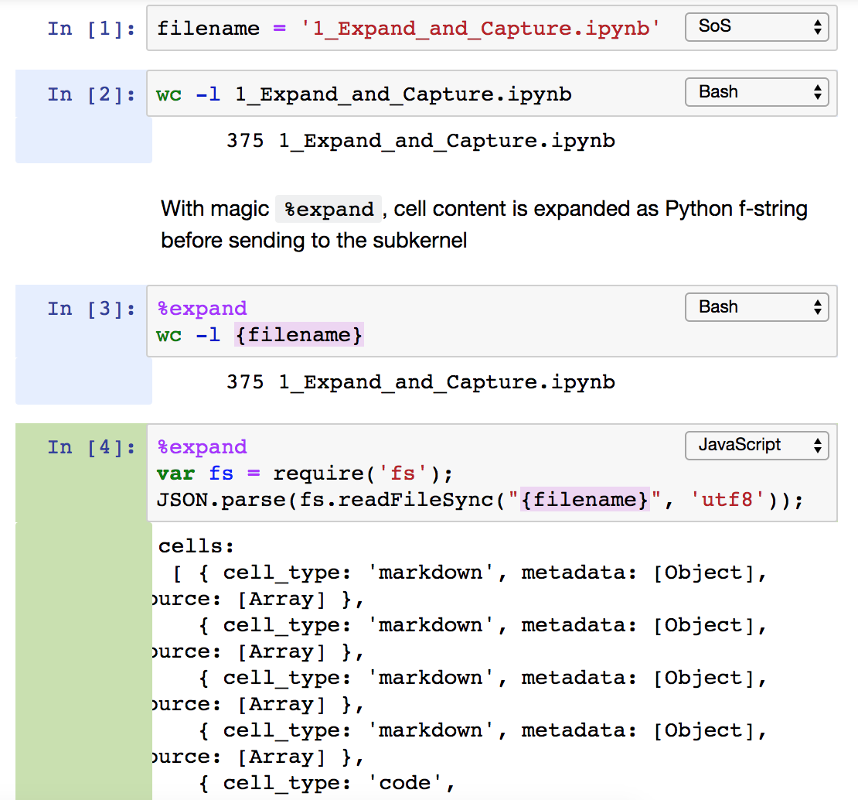
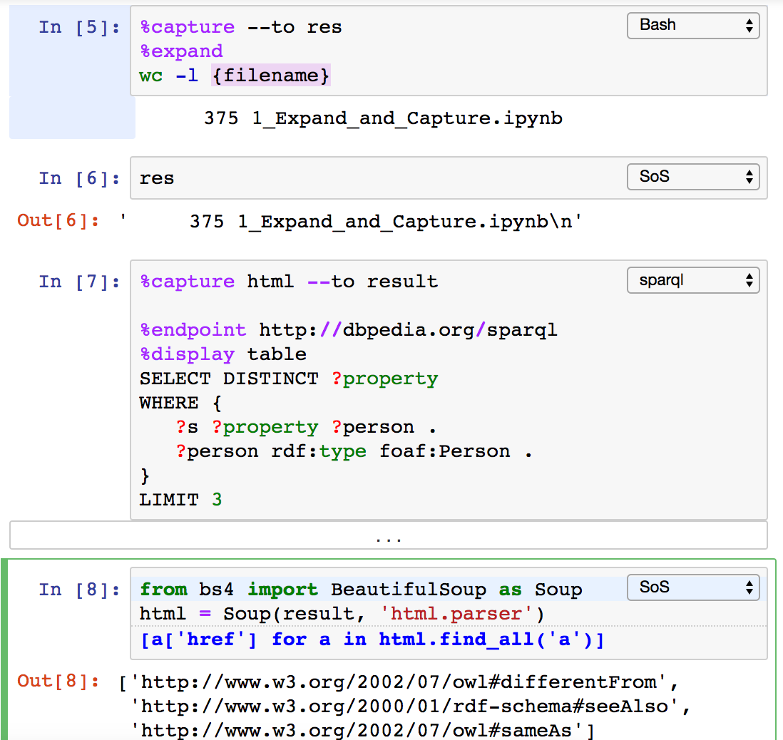
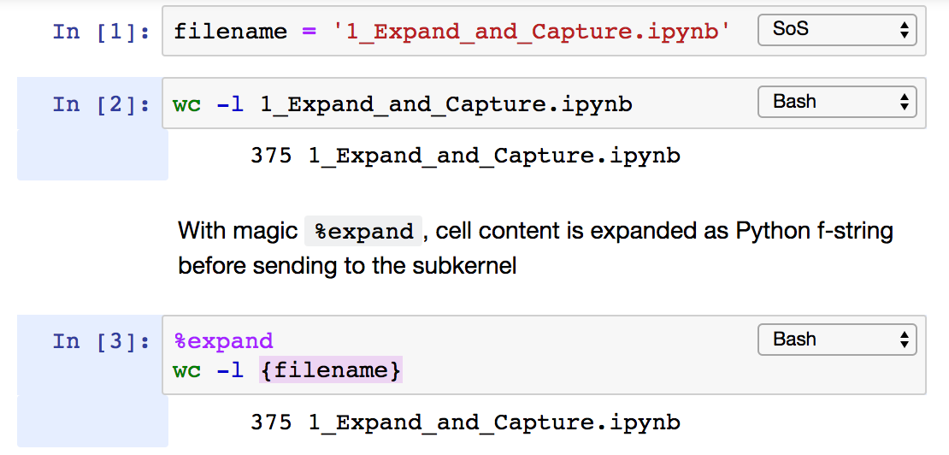
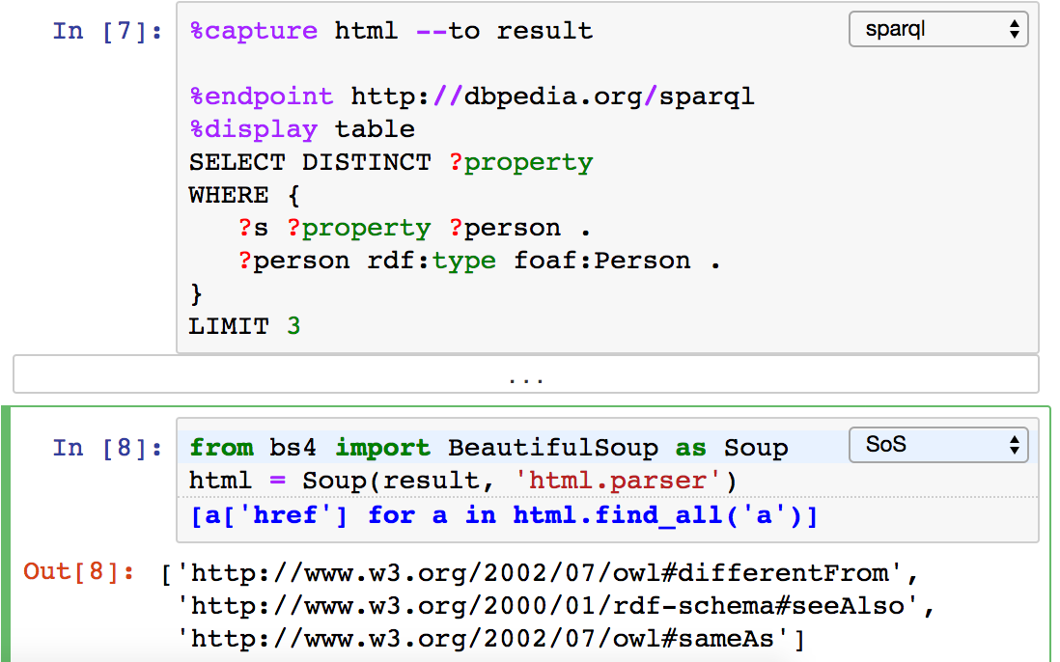
Prepare input and capture output of subkernels
Polyglot Notebook

Slide 14
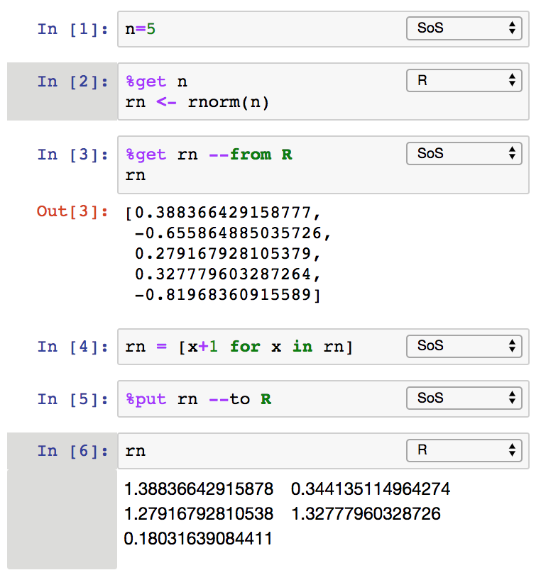
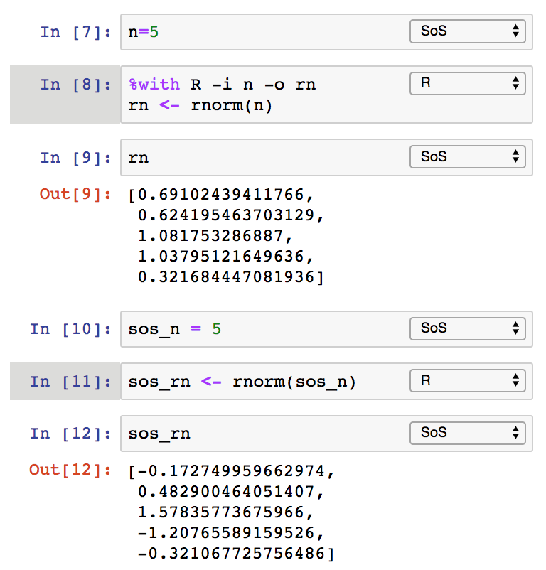
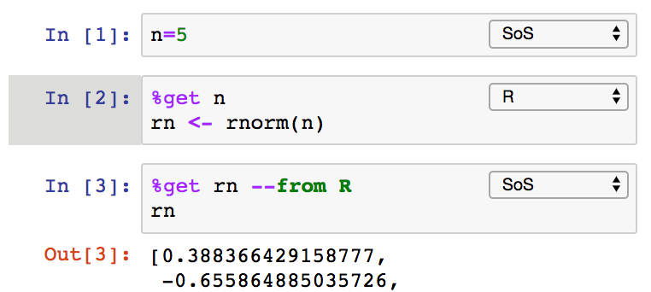
Data Exchange (magics %get, %put, and %with)
Polyglot Notebook
Notes:
Three ways but all based on the first magic

Slide 15
How data exchange works
Polyglot Notebook
arr: [1, 2, 3]
Kernel
df: pandas.DataFrame(…)
%put arr --to R
df = feather.read_dataframe(tmpfile)
write_feather(df, tmpfile)
arr <- c(1, 2, 3)
Kernel
%put df
arr: c(1, 2, 3)
df: data.frame(…)

Slide 16








Data exchange between SoS and supported subkernels
Polyglot Notebook
a=1
b=c(1,2)
Kernel
Create independent variables in another kernel
Direct data exchange between subkernels, or by way of SoS
Create variables of similar types
One to many (e.g. 1, c(1,2) in R)
Many to one (e.g. Char and str in Julia)
Intended to support a majority of datatypes, but with no guarantee of lossless data exchange
Supports kernels for 11 languages now
a=1
b=[1,2]
Kernel
c='x'
d='Hello'
Kernel
c='x'
d="Hello"

Slide 17
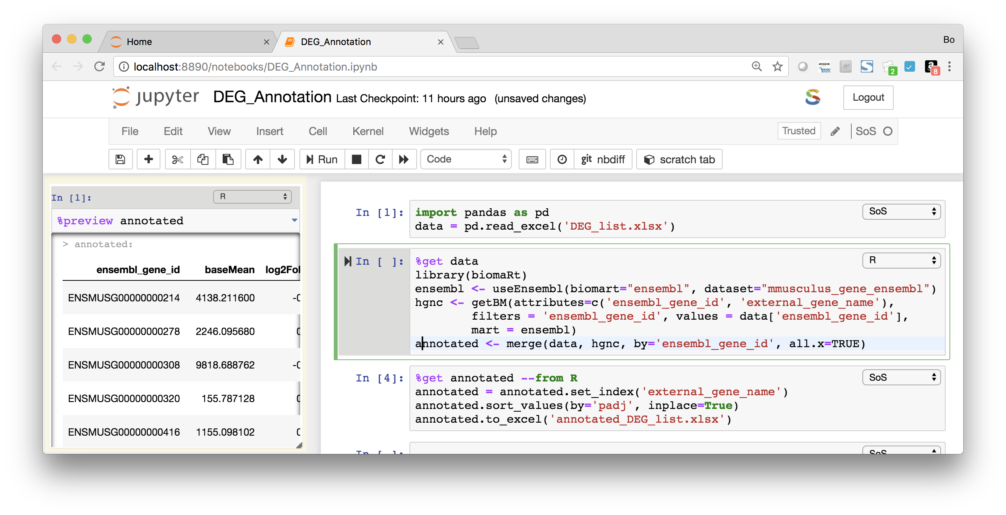
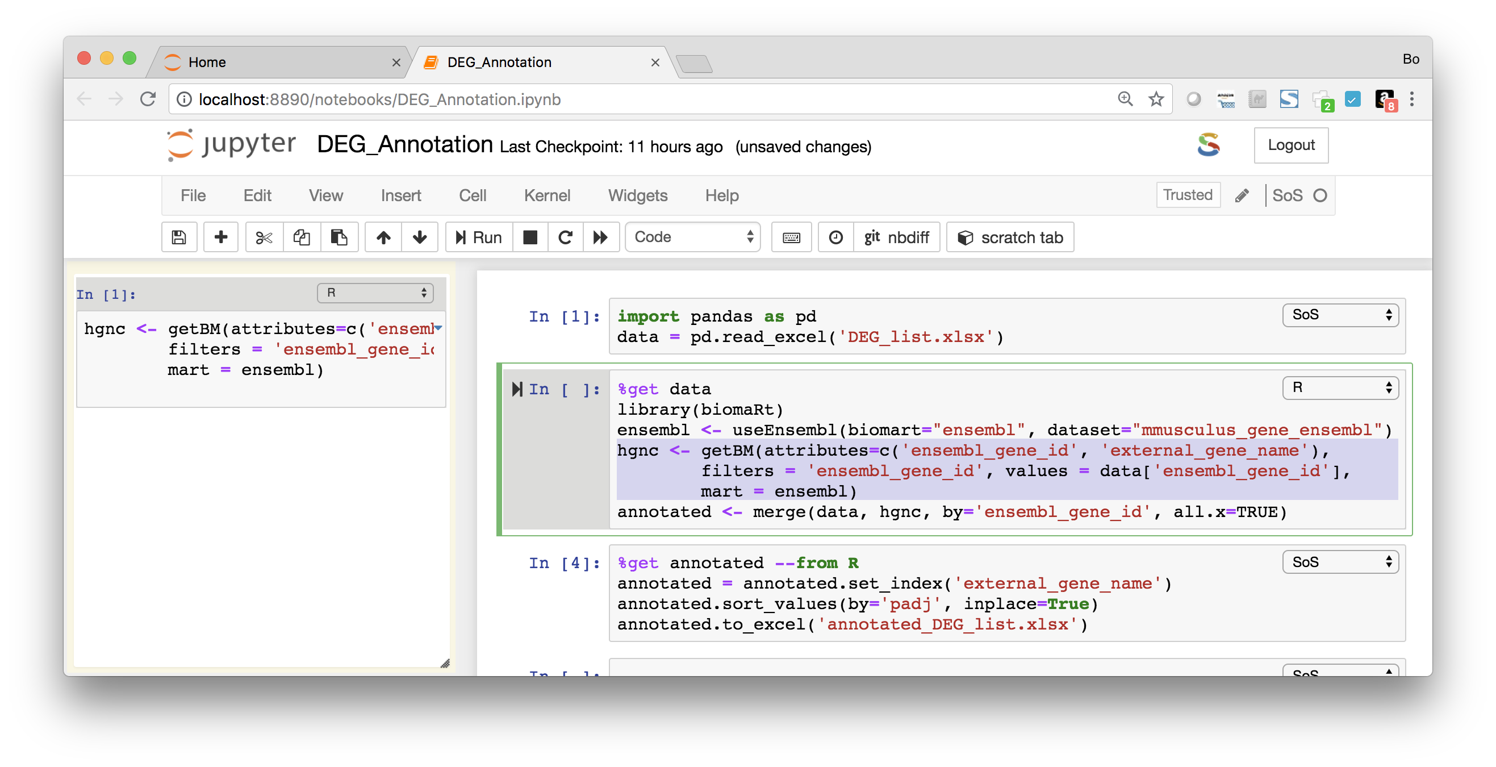
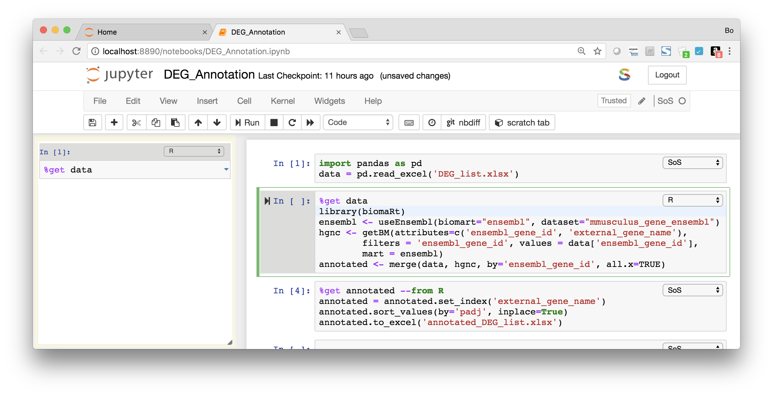
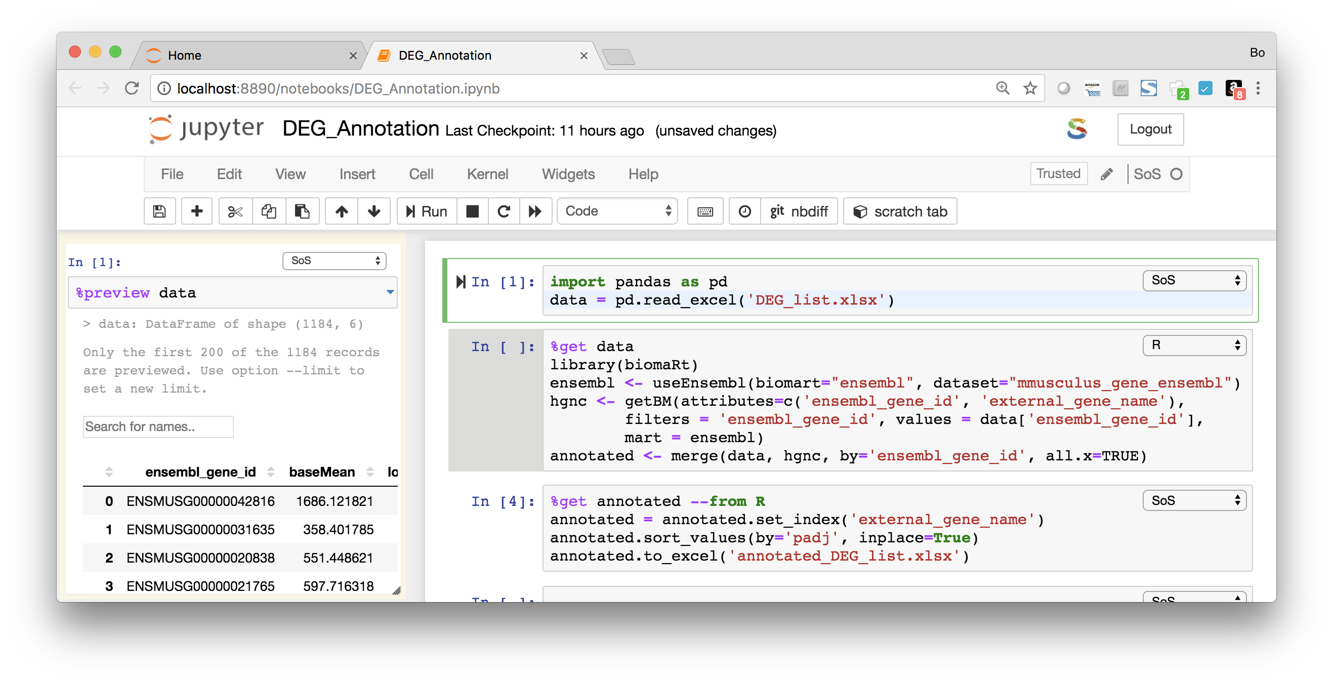
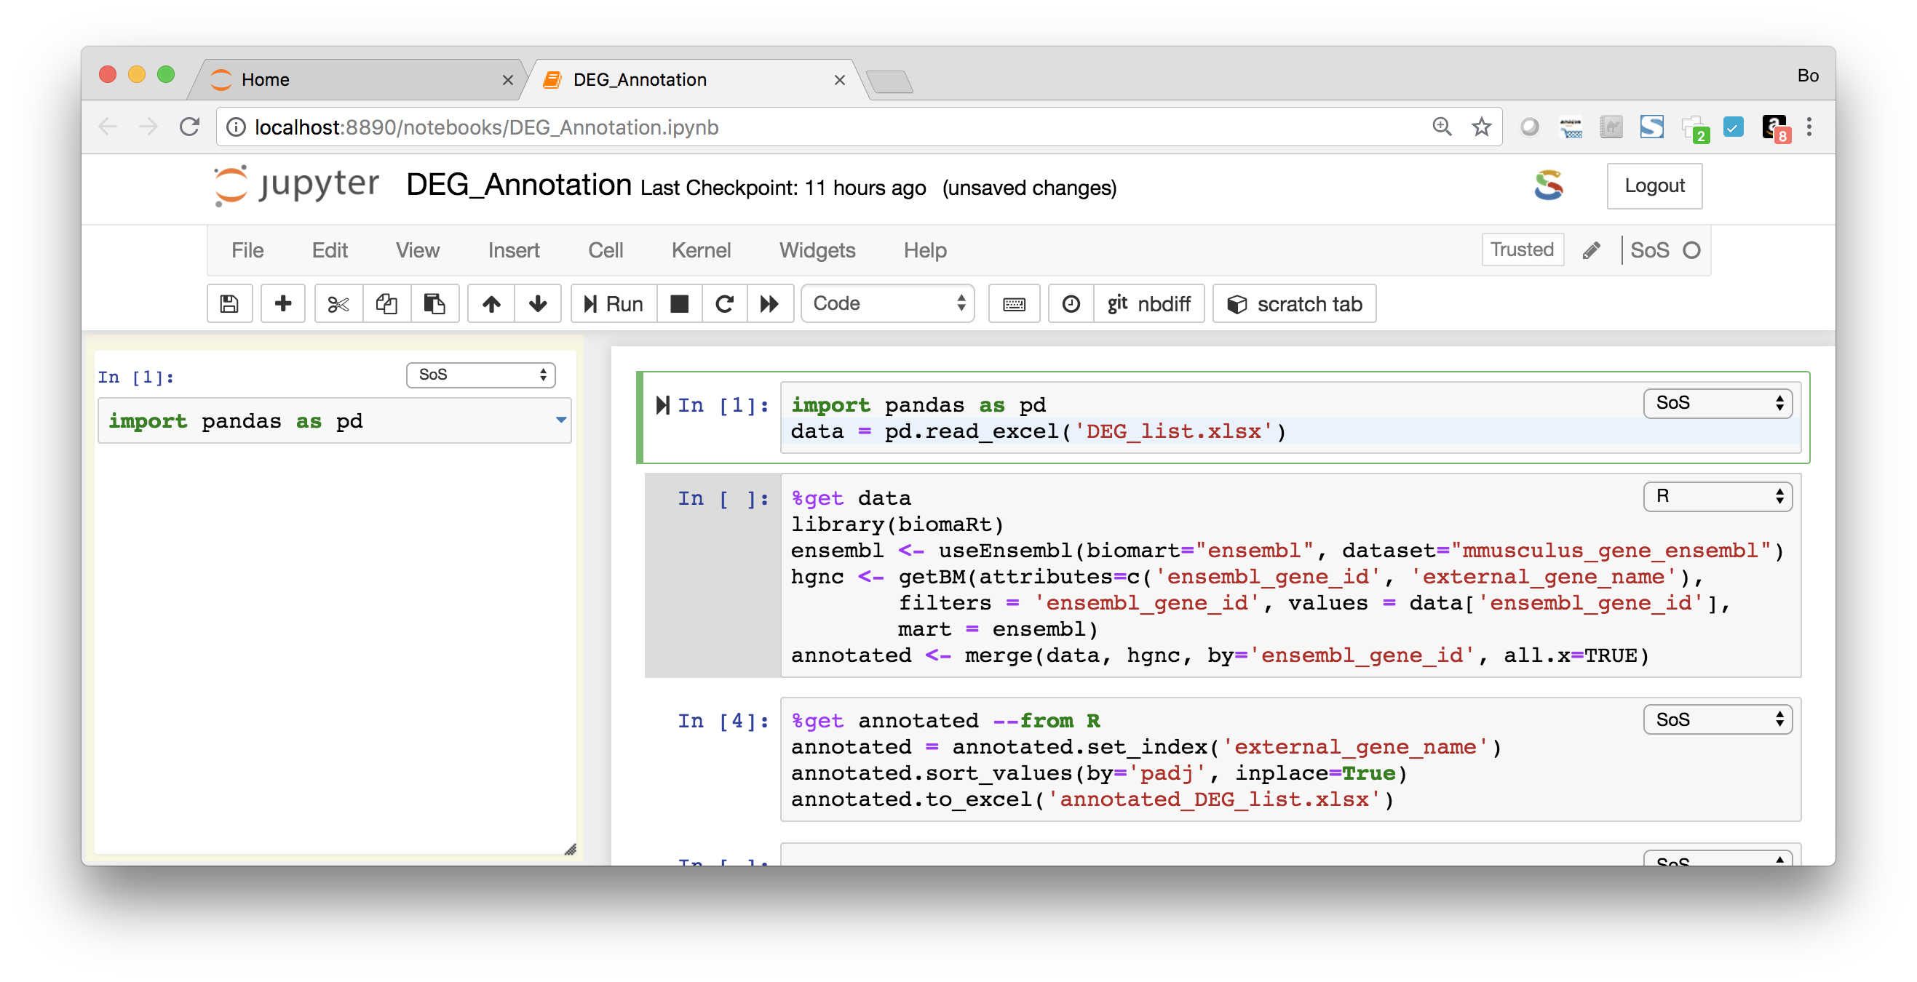
Line-by-line execution in side panel (Ctrl-Shift-Enter)
Polyglot Notebook
Command notebook:run-in-console is available in JupyterLab to execute code in a console panel, a default shortcut is not yet assigned.

Slide 18
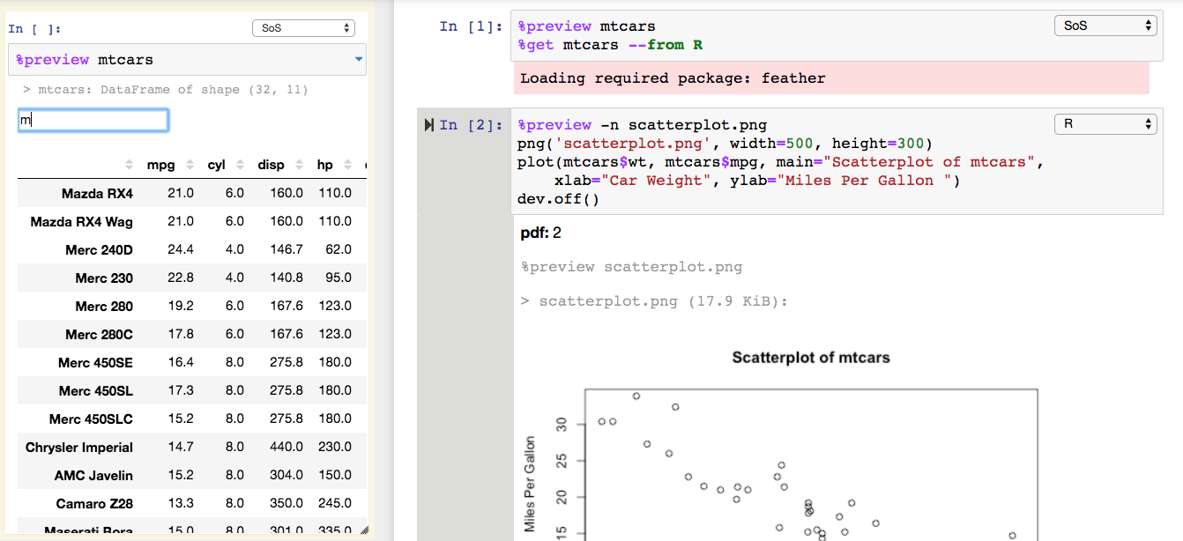
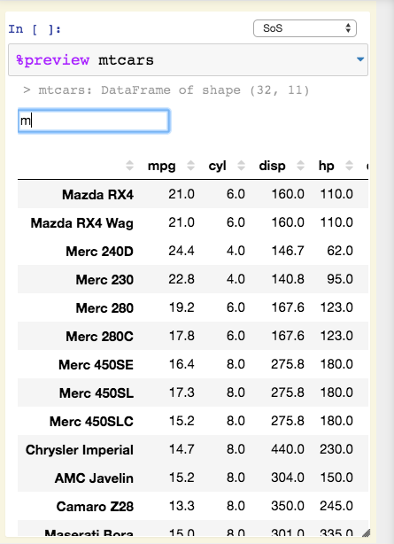
Preview of expressions and files
Polyglot Notebook
JupyterLab PR #4879 for displaying transient information from kernels is pending.

Slide 19
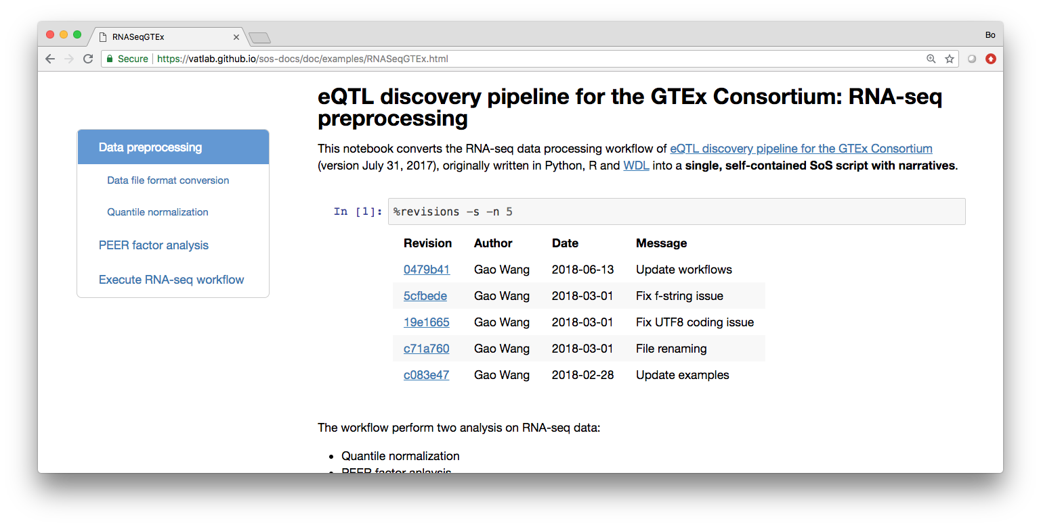
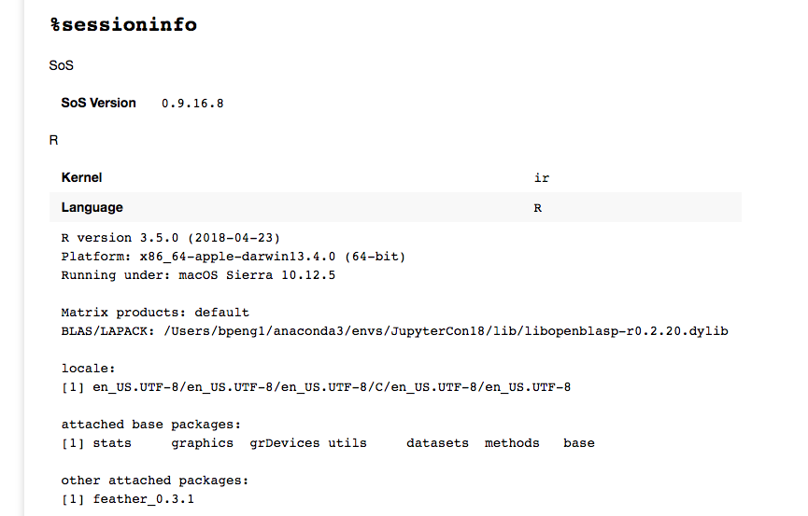
%revisions, %sessioninfo, and %sossave
Polyglot Notebook
%sossave is equivalent to sos convert from command line. Multiple templates are available.

Slide 20
Workflow System
+
=
Polyglot Notebook
Workflow System
Working Environment
Notes:
Start at 18

Slide 21
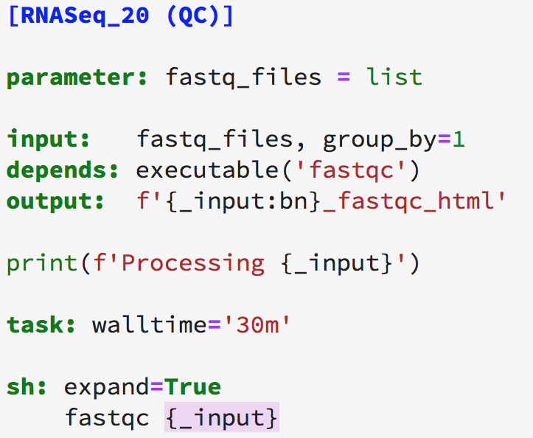
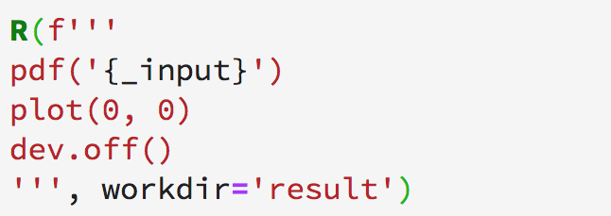
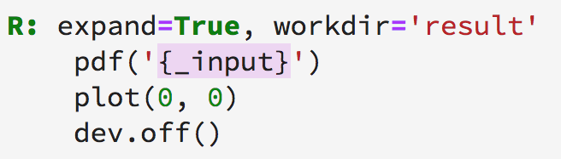
Overview of SoS Workflow Syntax
Workflow System
3.6+
Script format of function calls
Step header and statements
Function format
Script format
Headers define “steps” of workflows
input, output, and depends specify input, output and dependent targets of the step
task defines the rest of the step as external tasks
Indentation is recommended but not required
Alternative sigil is allowed (e.g. expand='${ }')

Slide 22
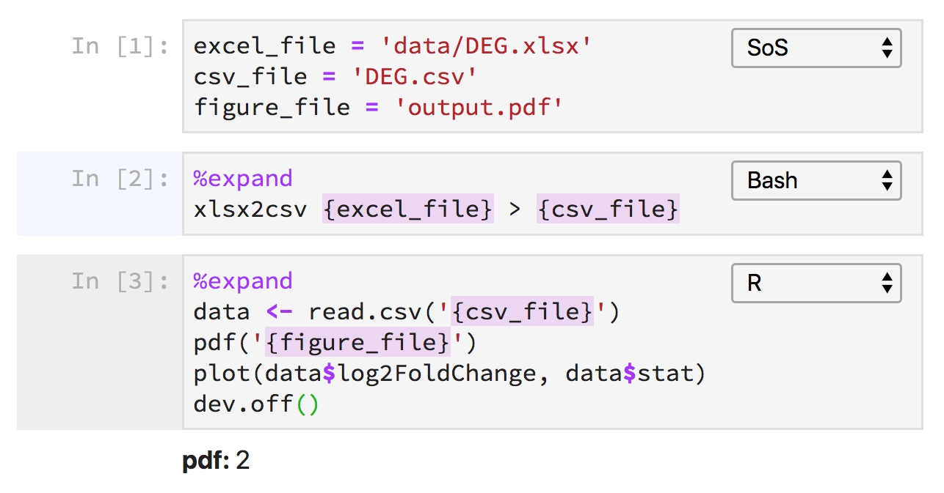
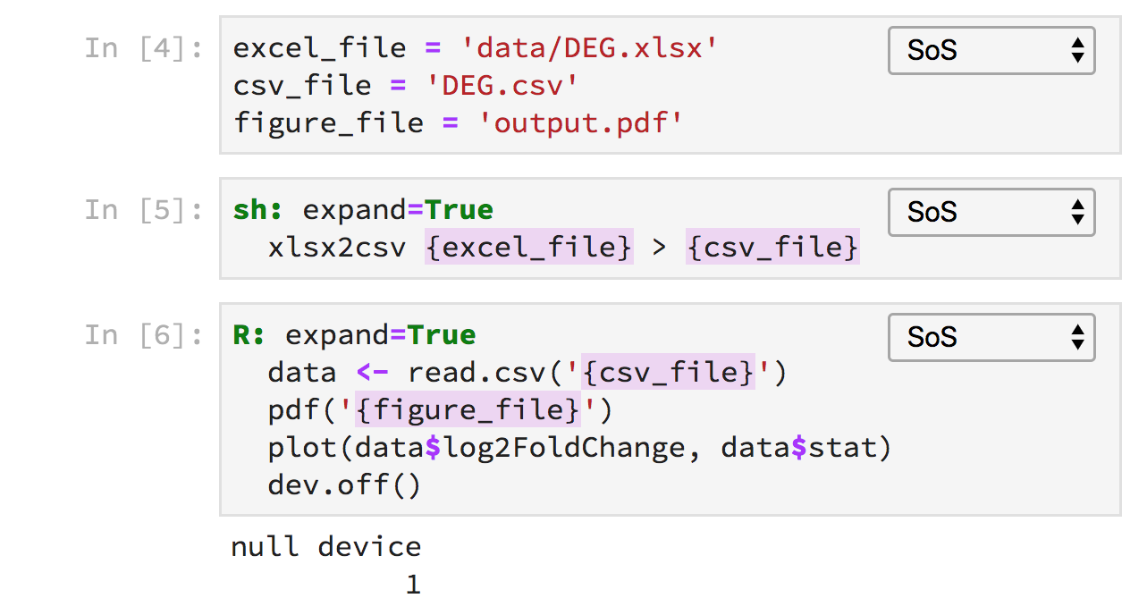
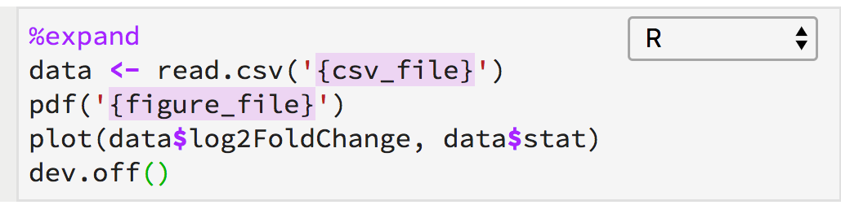
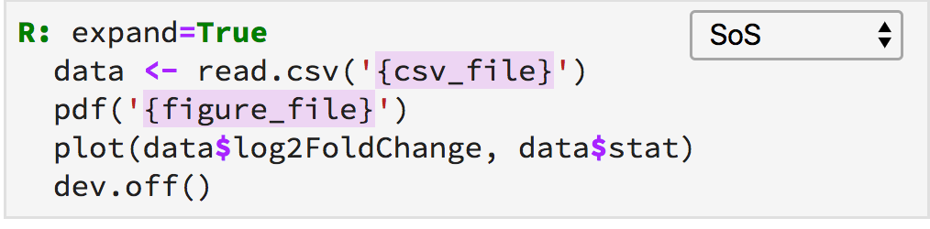
From subkernels to SoS kernel
Workflow System
Subkernels
Kernel
(possibly incomplete scripts)
(complete scripts)
Notes:
Explain what this workflow does

Slide 23
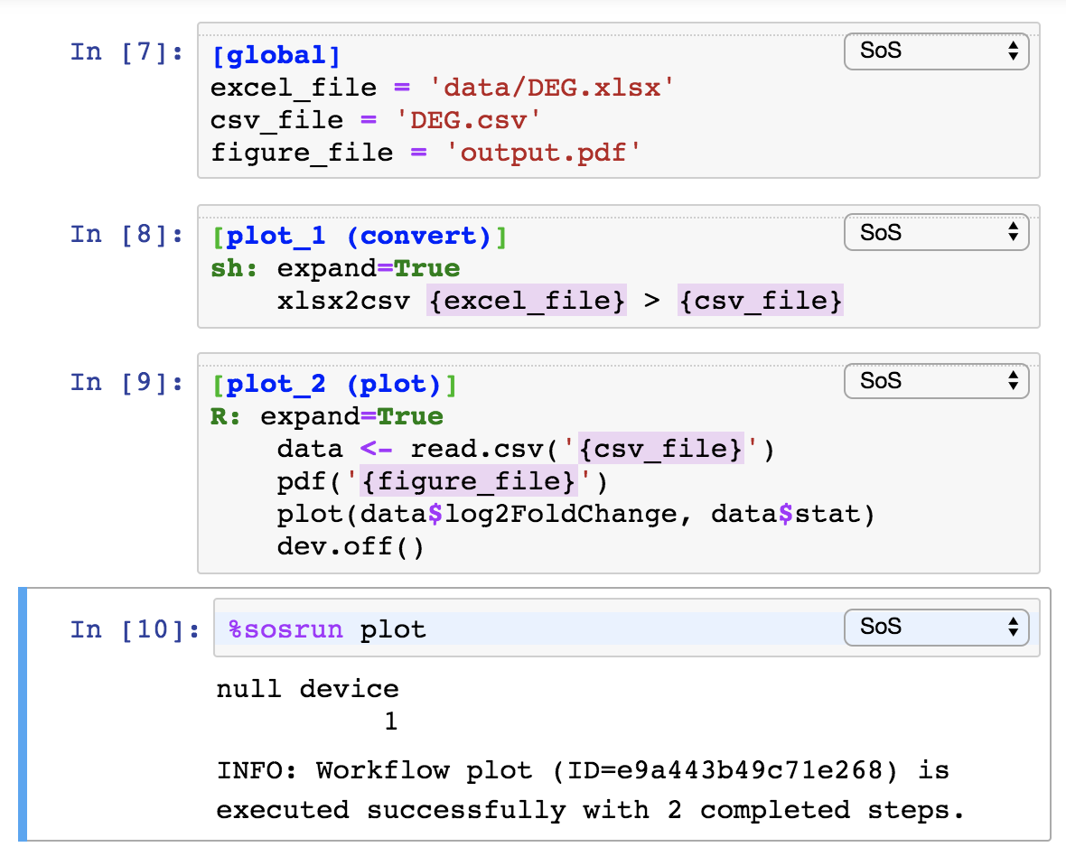
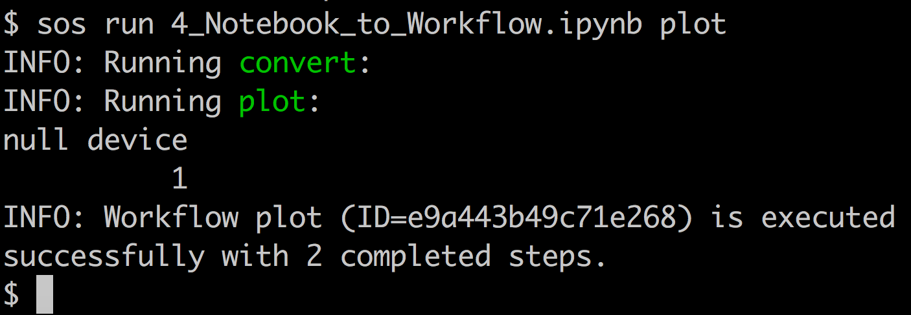
Embedded workflows in notebook
Workflow System
Kernel
Workflow
(shared kernel namespace)
(independent workflow namespace)

Slide 24
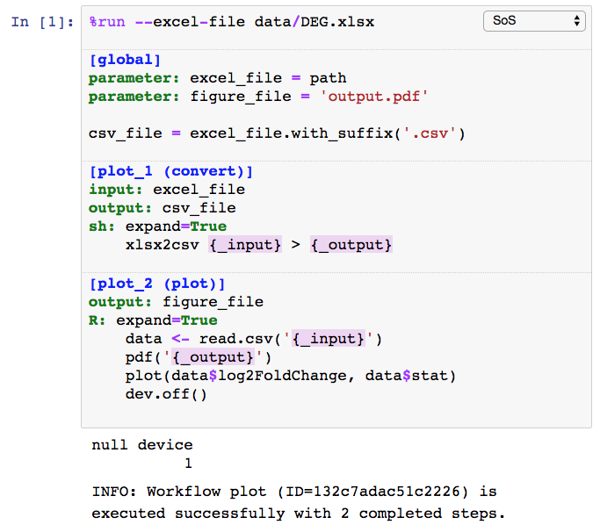
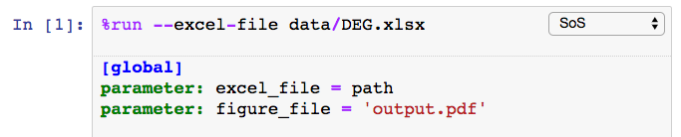
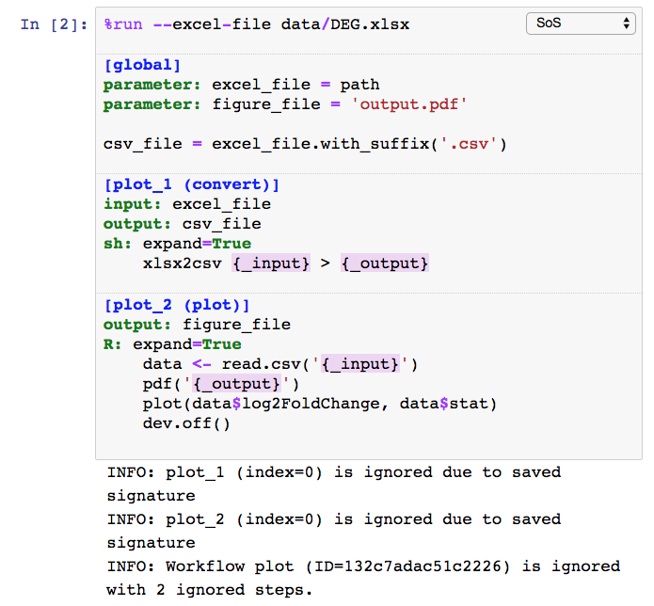
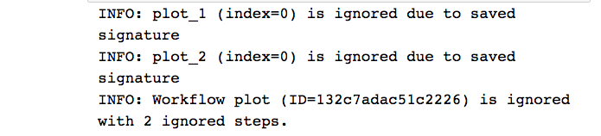
Parameters and runtime signatures
Workflow System

Slide 25
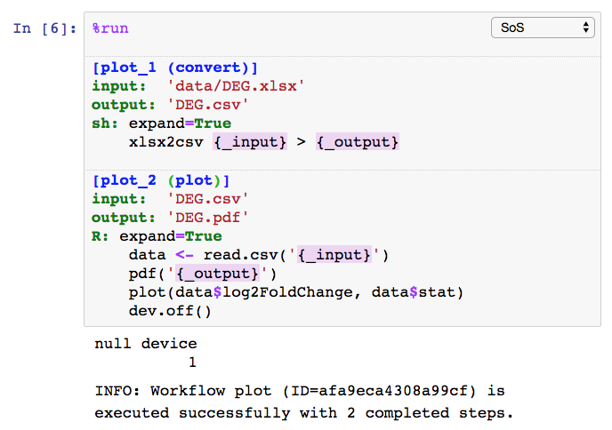
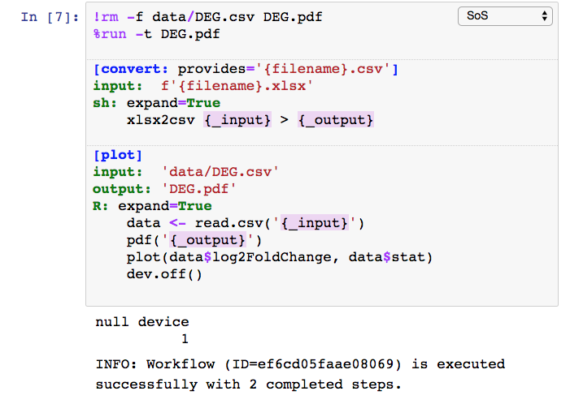
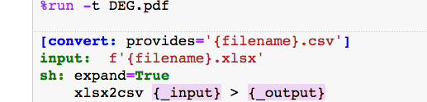
Process-oriented vs outcome-oriented workflows
Workflow System
Numerically numbered steps of a “process”
Execute sequentially (logically)
Steps can provides targets for others
Workflow constructed to generate specified targets (option –t)

Slide 26
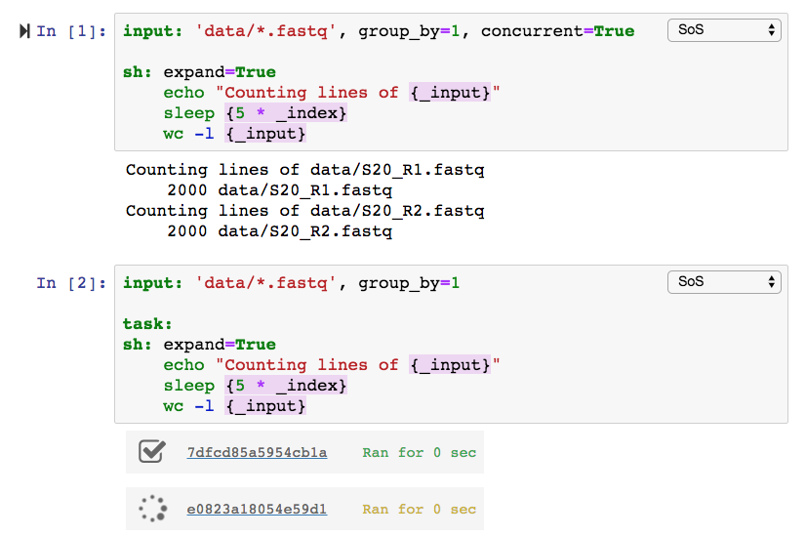
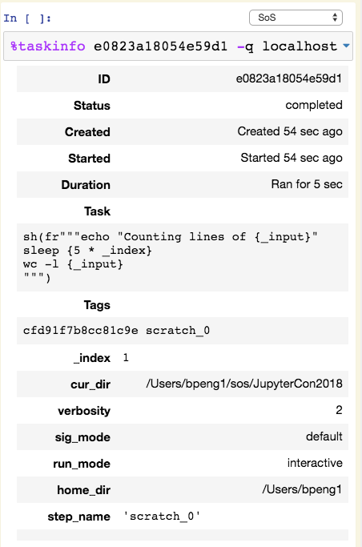
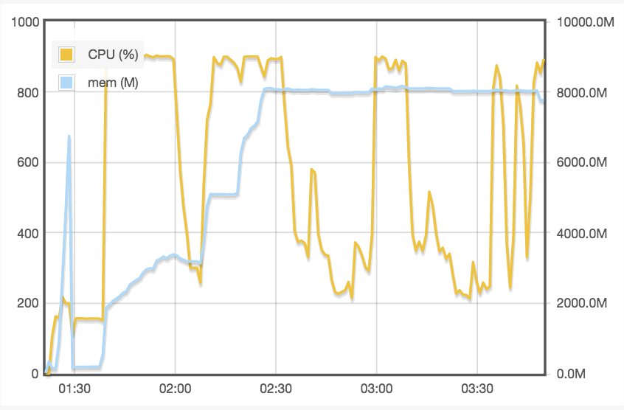
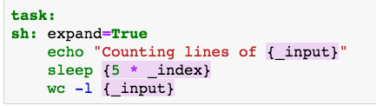
Concurrent execution and external tasks
Workflow System

Slide 27
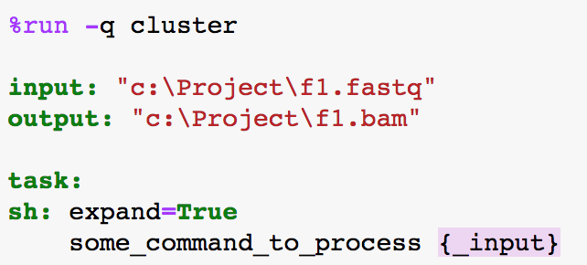




SoS task model
Workflow System
77e3c2ef7079a236.task
c:\Project\f1.fastq
c:\Project\f1.bam
input: “c:\Project\f1.fastq”
output: “c:\Project\f1.bam”
sh: expand=True
some_command_to_process {_input}
hosts.yml
77e3c2ef7079a236.task
/Project/f1.fastq
input: “/home/bpeng/Project/f1.fastq”
output: “/home/bpeng/Project/f1.bam”
sh: expand=True
some_command_to_process {_input}
77e3c2ef7079a236.sh
/Project/f1.bam
#PBS –N 77e3c2ef7079a236
#PBS –l nodes=1:ppn=1:mem=10G
#PBS –l walltime=24:00:00
cd /home/bpeng1/Project
sos execute 77e3c2ef7079a236

Slide 28

Execute scripts in docker containers
Workflow System

Slide 29



DAG and workflow reports
Workflow System

Slide 30
Summary
+
=
Polyglot Notebook
Workflow System
Working Environment
Notes:
Start at 36

Slide 31
Our previous computational environment
Summary

Slide 32
Our new computational environment
Summary

Slide 33

SoS notebooks for reproducible data analysis
Summary
+
=
Polyglot Notebook
Workflow System
Working Environment
Multi-language data analysis with data exchange
Side panel and magics for interactive data analysis
Powerful Python-based multi-style workflow system
Remote execution of external tasks
Environment for both interactive data analysis and batch data analysis
Reproducible notebooks

Slide 34
















SoS Status
Summary
https://vatlab.github.io/SoS
https://github.com/vatlab
License:
sos 0.16.9
sos-notebook 0.16.10
jupyterlab-sos 0.2.4
Languages:
Browser:
OS:
Jupyter:
Task queue:
Container:
bpeng@mdanderson.org
ScriptOfScripts
https://vatlab.github.io/blog

Slide 35



Acknowledgements
Summary
Gao Wang (U Chicago)
Jun Ma
Man Chong Leong
Chris Wakefield
James Melott
Yulun Chiu
Di Du
Dr. John Weinstein
Dr. Christopher Amos (BCM)
Dr. Paul Scheet
Dr. Suzanne Leal (BCM)
Grant R01HG008972
Grant 1R01HG005859 (Dr. Paul Scheet)
CPRIT RP130397
Gordon and Berry Moore Foundation (#4559)
The Michael and Susan Dell Foundation
The Chapman Foundation

Slide 36


Summary
https://vatlab.github.io/sos/live
Notes:
SoS has really changed the way we work, and it should work wonder for you!
Please test and let us know what you think.

